Slide 1


Gustavo
October 2023

Slide 2

Outline
Executive Summary
Introduction
Methodology
Results
Conclusion
Appendix

Slide 3
Executive Summary
We collected Space X launch data, extracted the success rates based on engine, payload, launch site, and utilized that data to estimate the success rates of future missions
Data collection and wrangling
SQL EDA
Interactive map of launch sites and launch outcomes
Dashboard with outcomes by site and engine
Classification and analysis
EDA results allowed us to assess the performance of the different models used and establish their suitability for predictive analysis

Slide 4
Introduction
SpaceX has launched multiple rockets over the last ~10 years, with increasing success rate. It has become one of the principal NASA contractors to assist with their operations, current, and future missions, with Falcon 9 being one of its main reusable rockets.
Upon analyzing data of Falcon 9 rockets, we wish to answer a few questions:
Can we develop a model that accurately predicts the success rate of a launch based on factors such as engine used and payload?
Can we apply this model to guide future operations?

Slide 5

Section 1

Slide 6
Methodology
Executive Summary
Data collection methodology:
Data was collected directly from SpaceX using its own API
Web scraping from Wikipedia
Perform data wrangling
Data was further processed through One Hot Encoding, by removing null values and focusing on the variables of interest, such as launch outcome, booster version, and orbit
Perform exploratory data analysis (EDA) using visualization and SQL
Perform interactive visual analytics using Folium and Plotly Dash
Perform predictive analysis using classification models
Models include logistic regression, KNN, SVM, decision trees

Slide 7
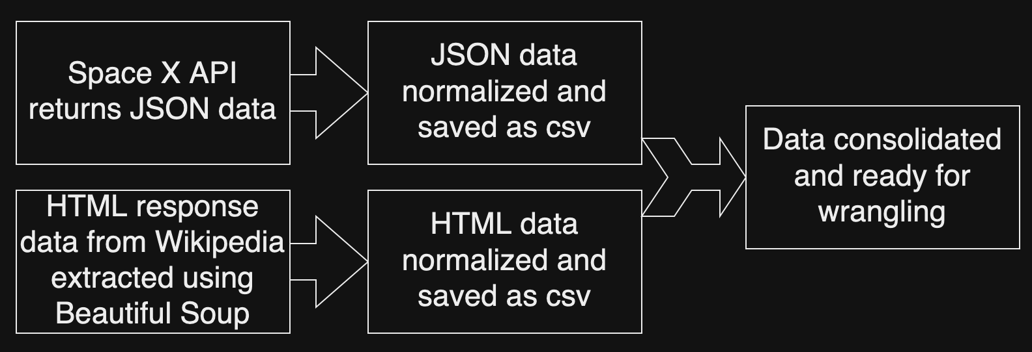
Data Collection
Data was collected through the SpaceX API and further web scraping was performed on Wikipedia
Data includes launch data, payload, engine, launch site, landing outcome

Slide 8
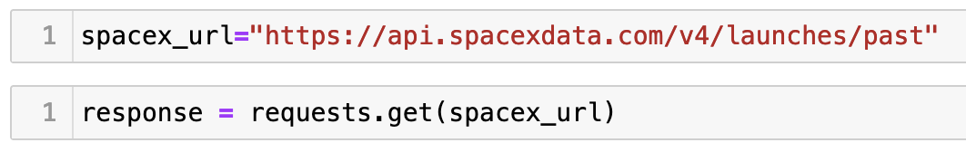
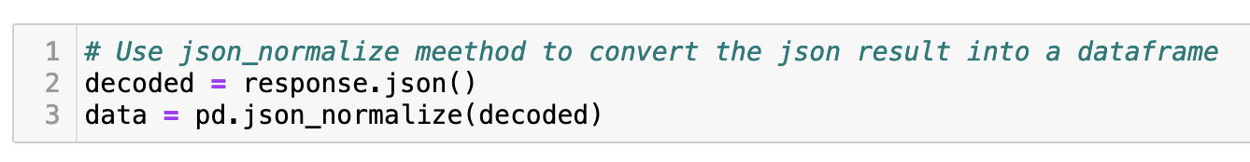
Data Collection – SpaceX API
1. Response converted to .json file
Data collection with SpaceX API
See the Github for further details:
2. Response converted to .json file
3. See Github for details of function calling to clean data
4. Data saved to csv file

Slide 9
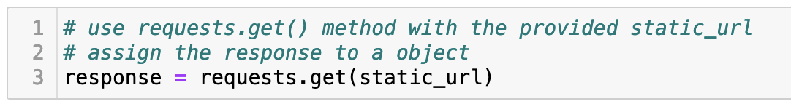
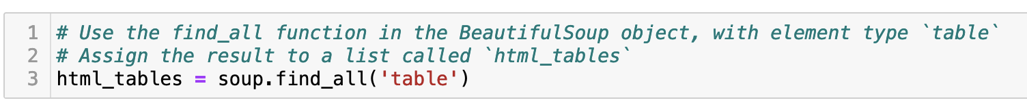
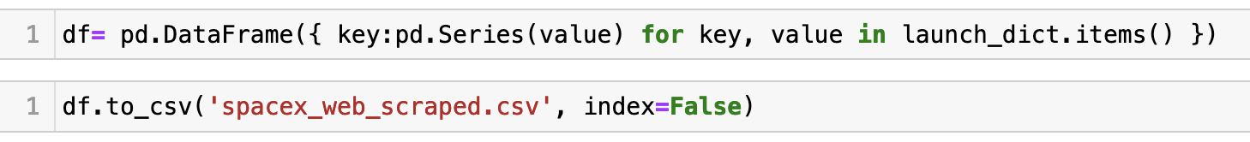
Data Collection - Scraping
1. Response obtained and assigned to Beautiful Soup object
Wikipedia web scraping
See Github for details
2. Extracting tables
3. See Github for details of dataframe creation and further data manipulation
4. Final dataframe creating and saving data into a csv file

Slide 10
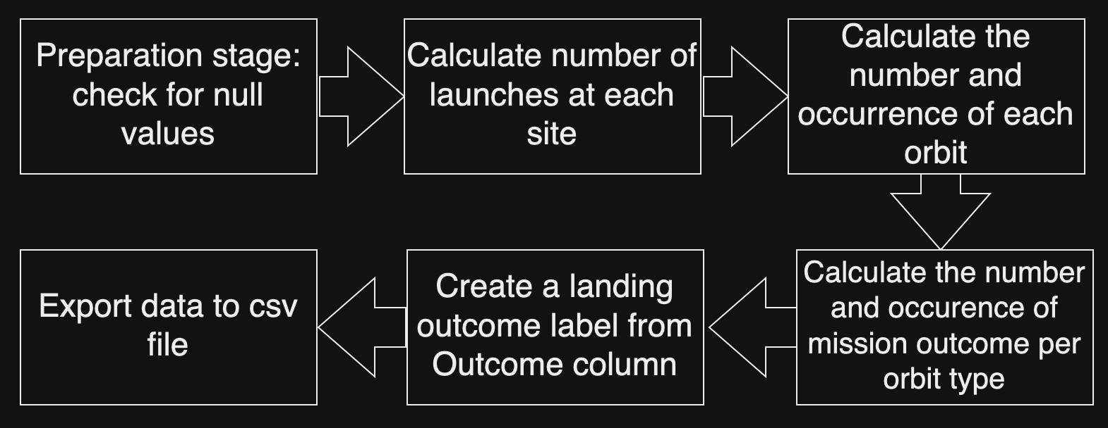
Data Wrangling
Check Github for details

Slide 11
EDA with Data Visualization
Charts plotted include (see Github for details):
Flight number vs payload mass, to assess evolution of successful landings over time
Flight number vs launch site, to assess differences in success rates over different sites, over time
Payload mass vs launch site, to assess the sites capabilities with respect to payload
Orbit type vs success rate, to assess what orbits are more challenging
Flight number vs orbit, to assess if the success rate of different orbit categories changes over time
Payload vs orbit, to assess if the payload affects the success of a launch depending on the orbit
Success rate vs year, to assess the evolution of successful launches per year

Slide 12
EDA with SQL
Some SQL queries performed:
Display the names of the unique launch sites in the space mission
Display 5 records where launch sites begin with the string 'CCA’
Display the total payload mass carried by boosters launched by NASA (CRS)
Display average payload mass carried by booster version F9 v1.1
List the date when the first succesful landing outcome in ground pad was acheived.
List the names of the boosters which have success in drone ship and have payload mass greater than 4000 but less than 6000
List the total number of successful and failure mission outcomes
List the names of the booster_versions which have carried the maximum payload mass. Use a subquery
List the records which will display the month names, failure landing_outcomes in drone ship ,booster versions, launch_site for the months in year 2015.
Rank the count of landing outcomes (such as Failure (drone ship) or Success (ground pad)) between the date 2010-06-04 and 2017-03-20, in descending order.

Slide 13
Build an Interactive Map with Folium
Map objects such as markers, circles, lines, etc. were added to the map to find optimal locations for building a launch site
See Github for details:

Slide 14
Build a Dashboard with Plotly Dash
Added to Plotly Dash:
Total success launches by site, to assess the success rates of each launch site
Success rates by payload, to assess the effects of different payloads on the success rates
See Github for details:

Slide 15
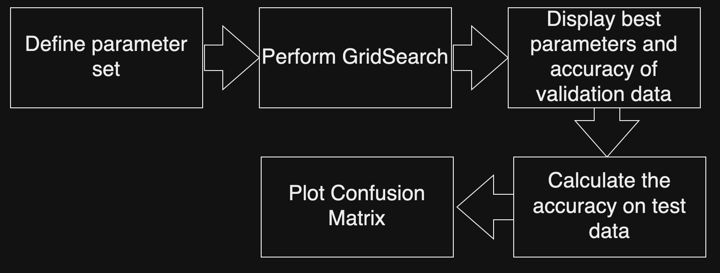
Predictive Analysis (Classification)
After splitting data into test and train data, we applied the procedure outlined on the flowchart to each classification method (see Github for details:)
We then compared the accuracies of each model to rank them

Slide 16
Results
Logistic regression, KNN and SVM models displayed the best prediction accuracy (83.3%)
The decision tree model had the worst prediction accuracy (77.8%)
Success rate of launches improved over the years
Lower payload masses perform better than higher payload masses

Slide 17

Section 2

Slide 18
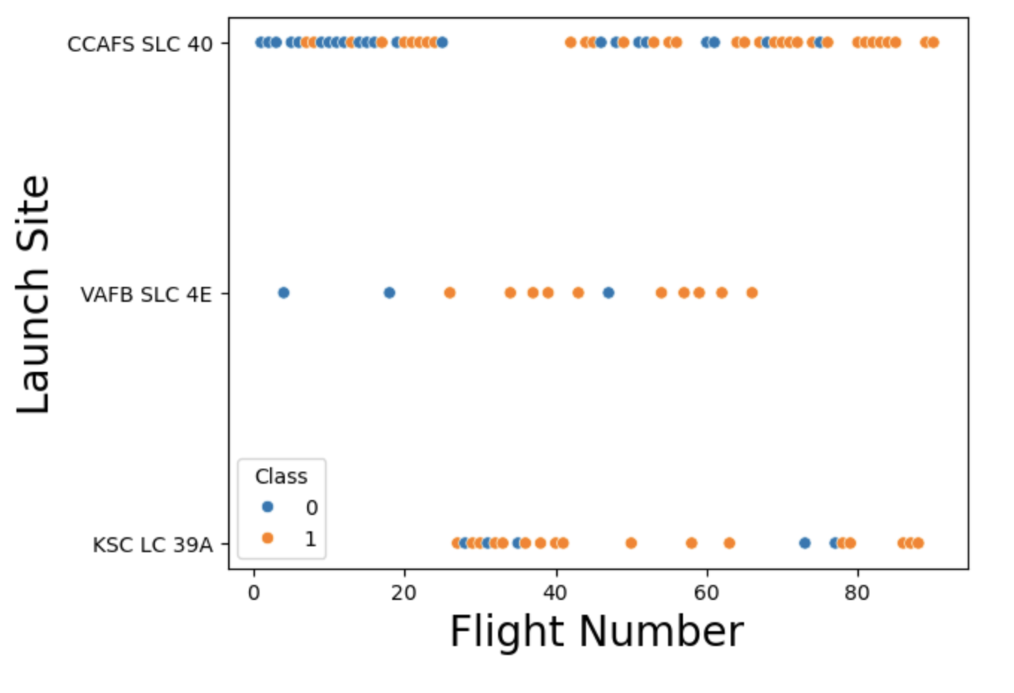
Flight Number vs. Launch Site
Sites CCAFS SLC 40 and VAFB SLC 4E displayed more successful launches over time
Site KSC LC 39A is unclear, with similar number of failed launches in the early days as well as in later days

Slide 19
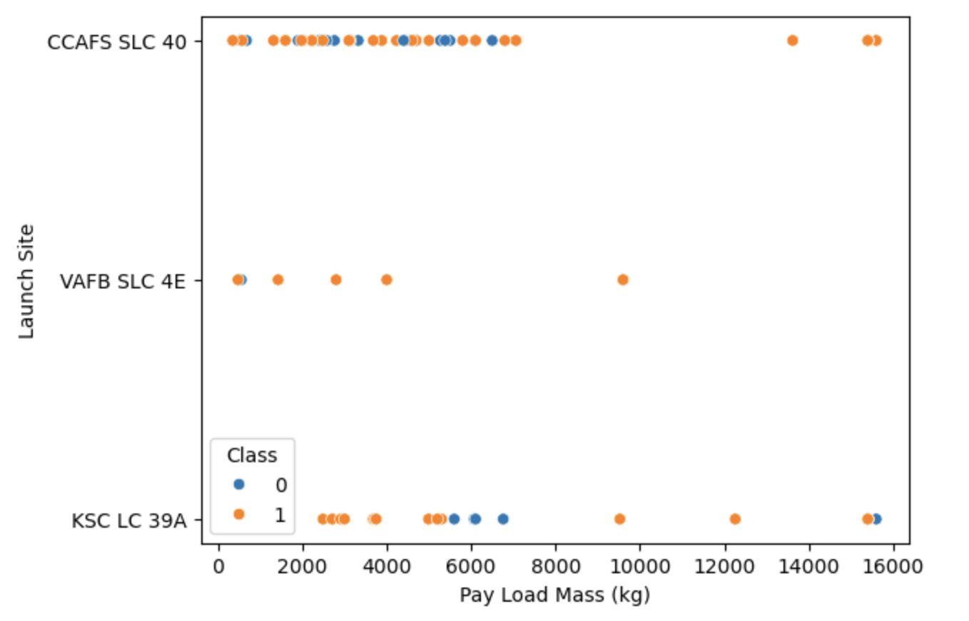
Payload vs. Launch Site
No heavy payload rockets in VAFB SLC 4E

Slide 20
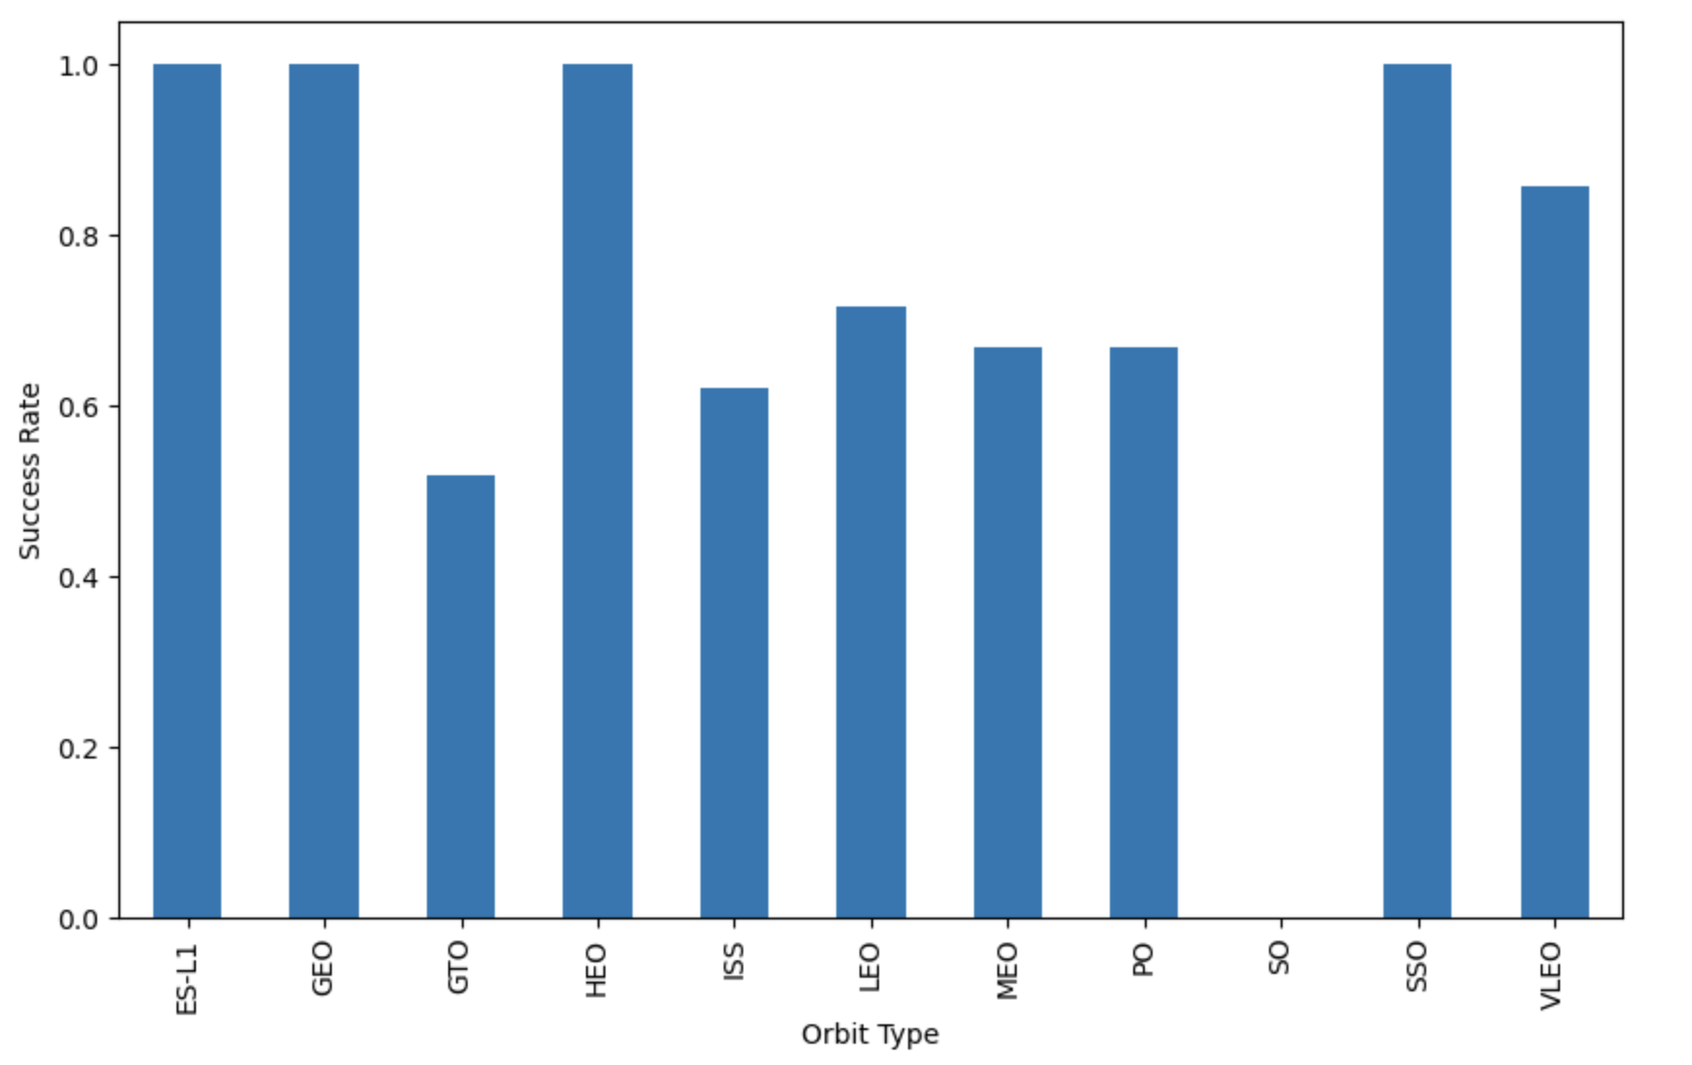
Success Rate vs. Orbit Type
ES-L1, GEO, HEO, SSO with perfect launch rates
GTO, ISS, SO with lowest success rates

Slide 21
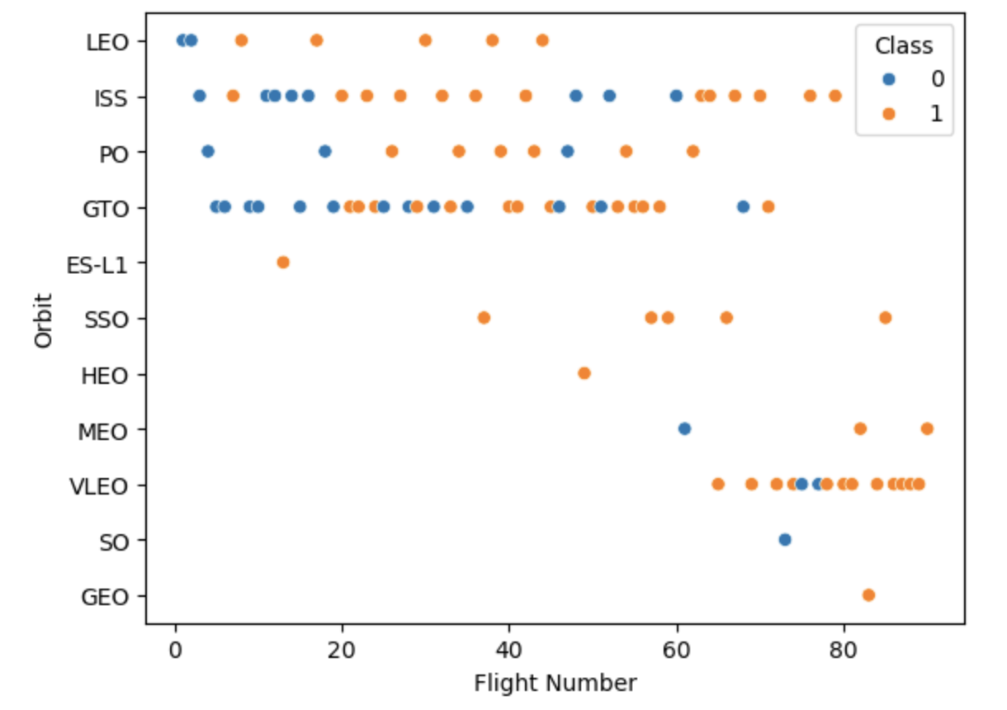
Flight Number vs. Orbit Type
More VLEO launches over the last few years
Overall increased success rate over the years (except SO, but only 1 launch)

Slide 22
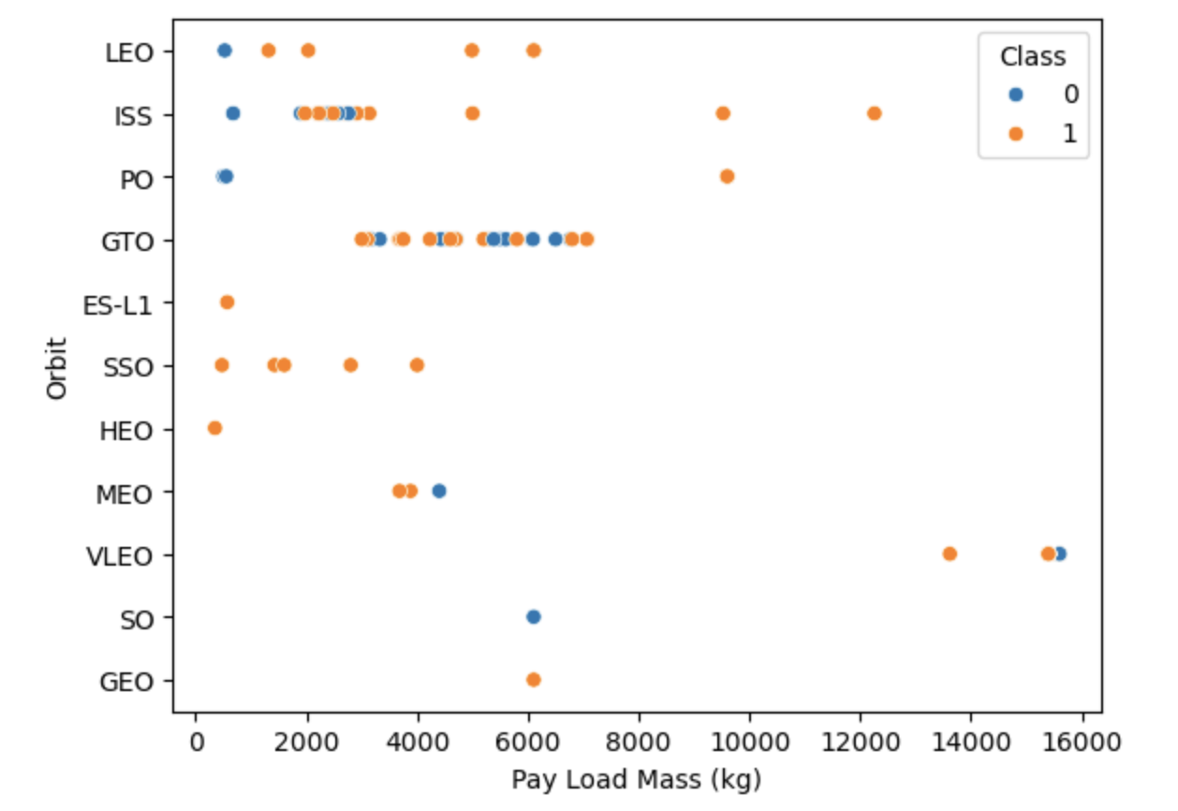
Payload vs. Orbit Type
Different success rates for different payloads and different orbit types, e.g.:
SSO only for lower payloads
LEO more successful at larger payloads

Slide 23
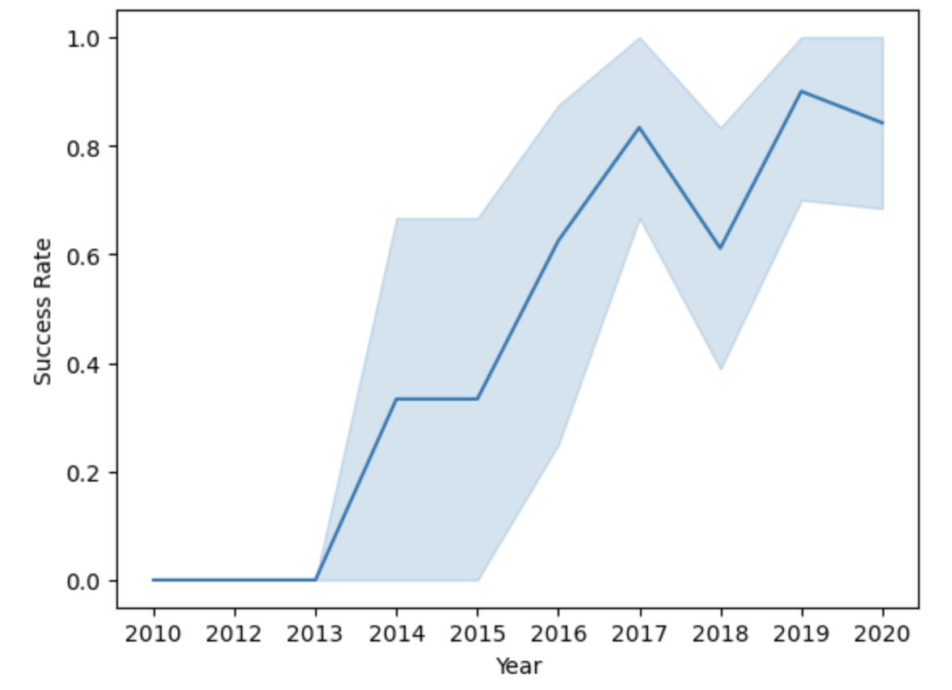
Launch Success Yearly Trend
Overall success rate increased over time

Slide 24
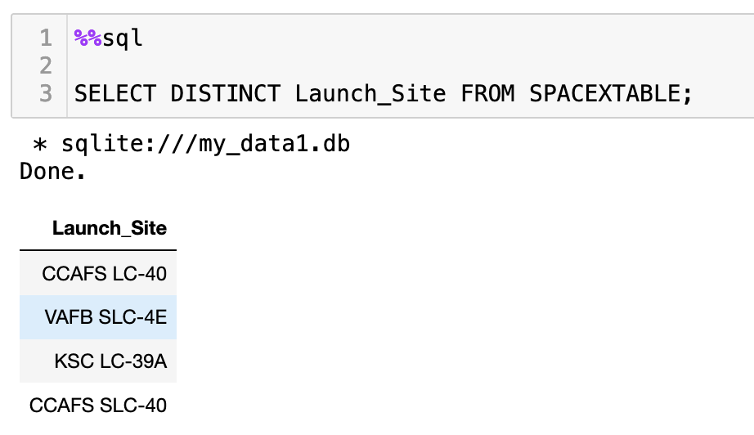
All Launch Site Names

Slide 25
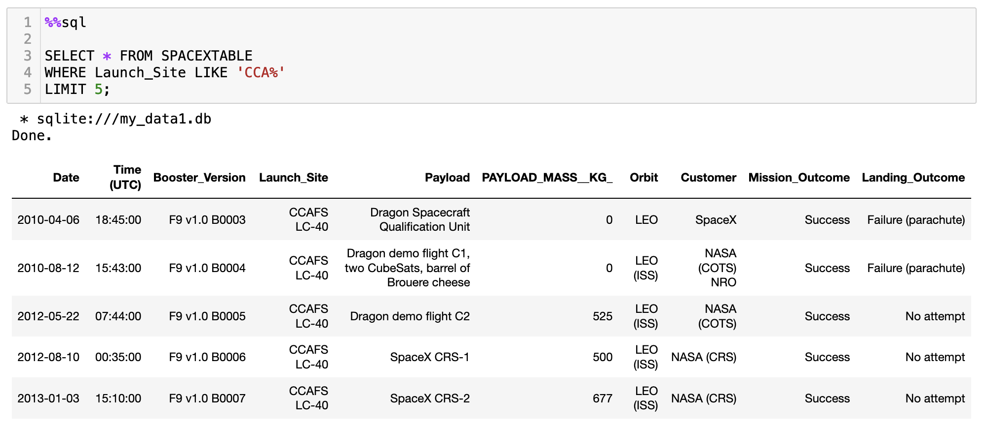
Launch Site Names Begin with 'CCA'

Slide 26
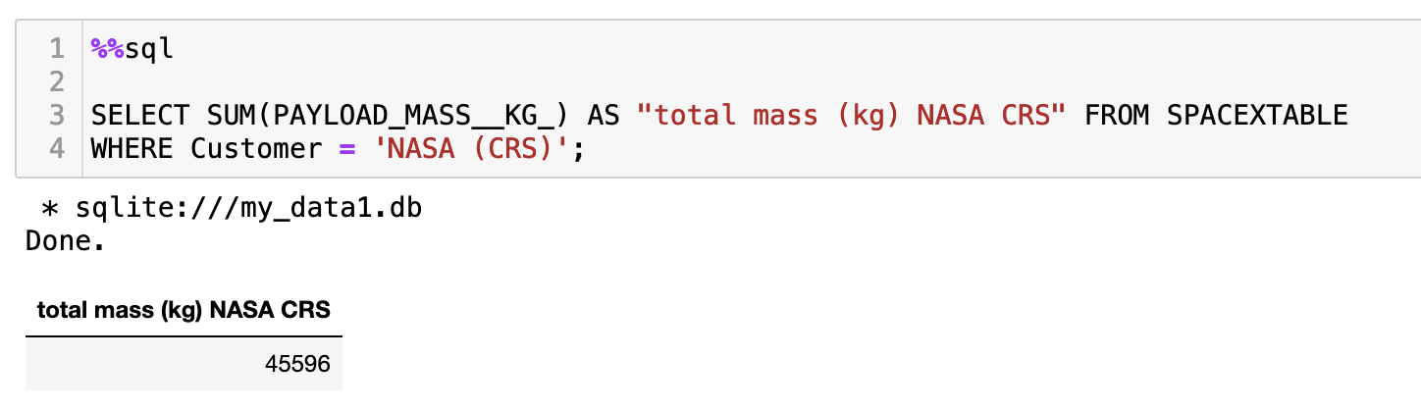
Total Payload Mass

Slide 27
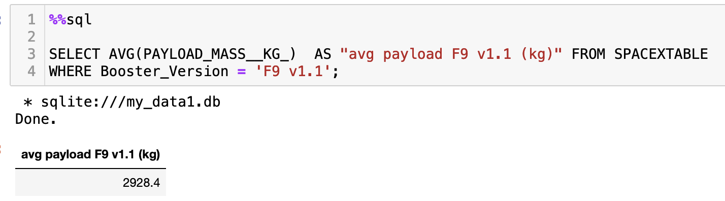
Average Payload Mass by F9 v1.1

Slide 28
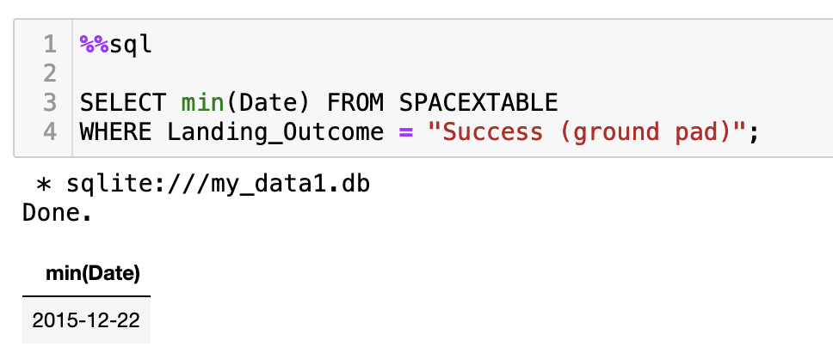
First Successful Ground Landing Date

Slide 29
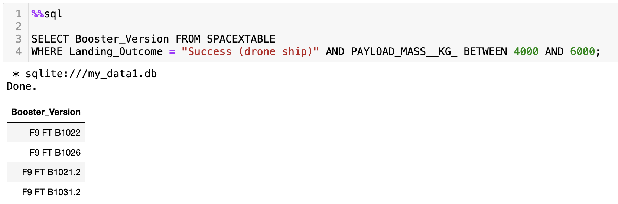
Successful Drone Ship Landing with Payload between 4000 and 6000

Slide 30
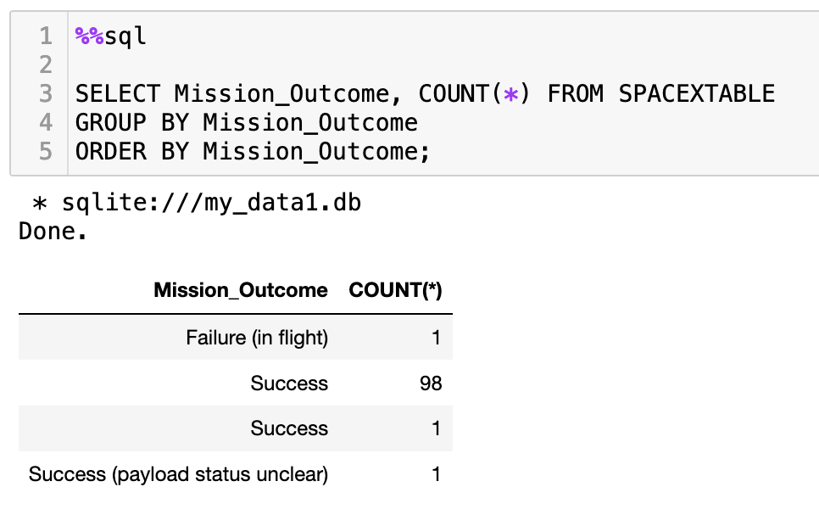
Total Number of Successful and Failure Mission Outcomes

Slide 31
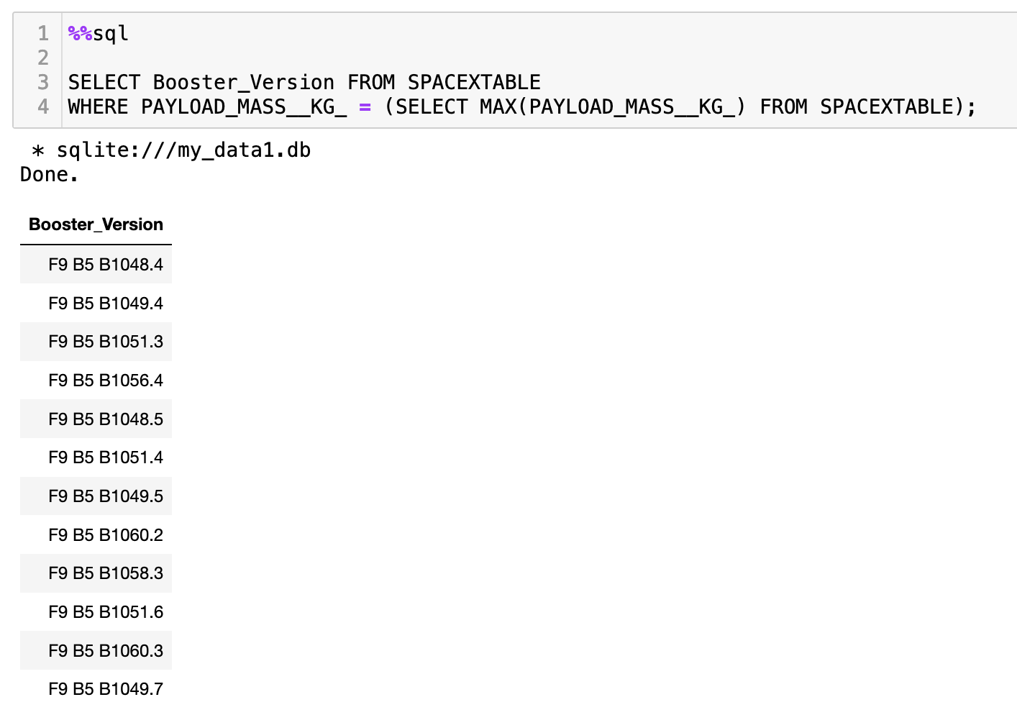
Boosters Carried Maximum Payload

Slide 32
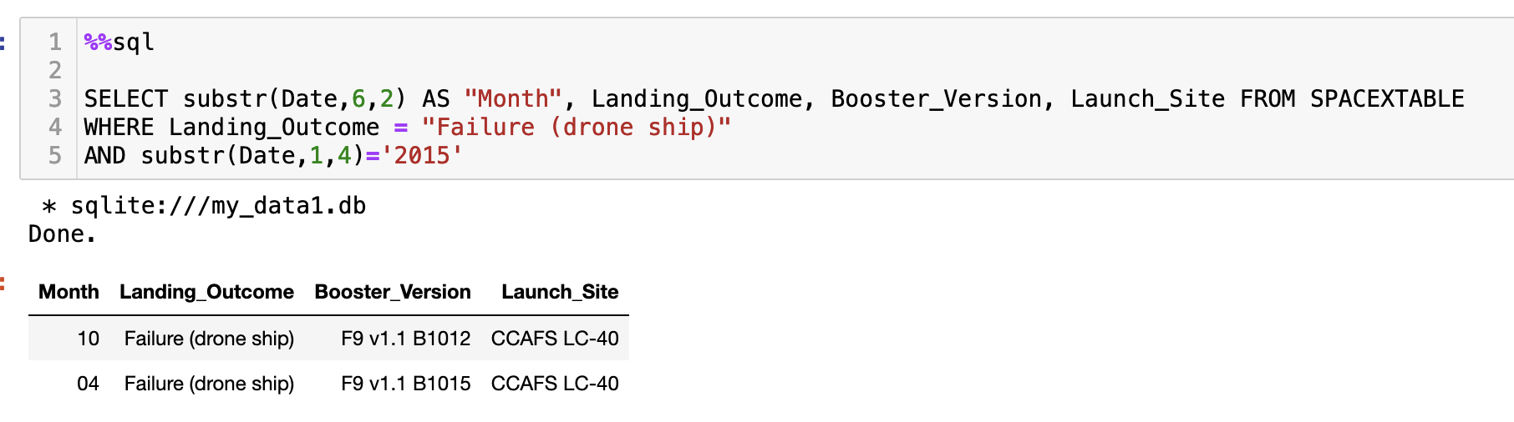
2015 Launch Records

Slide 33
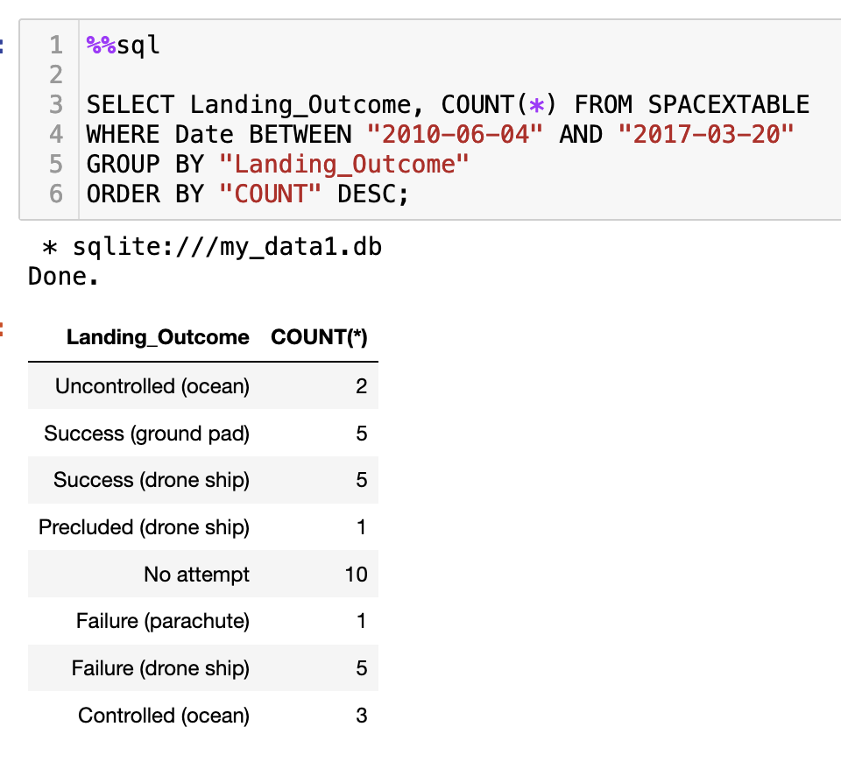
Rank Landing Outcomes Between 2010-06-04 and 2017-03-20

Slide 34

Section 3

Slide 35
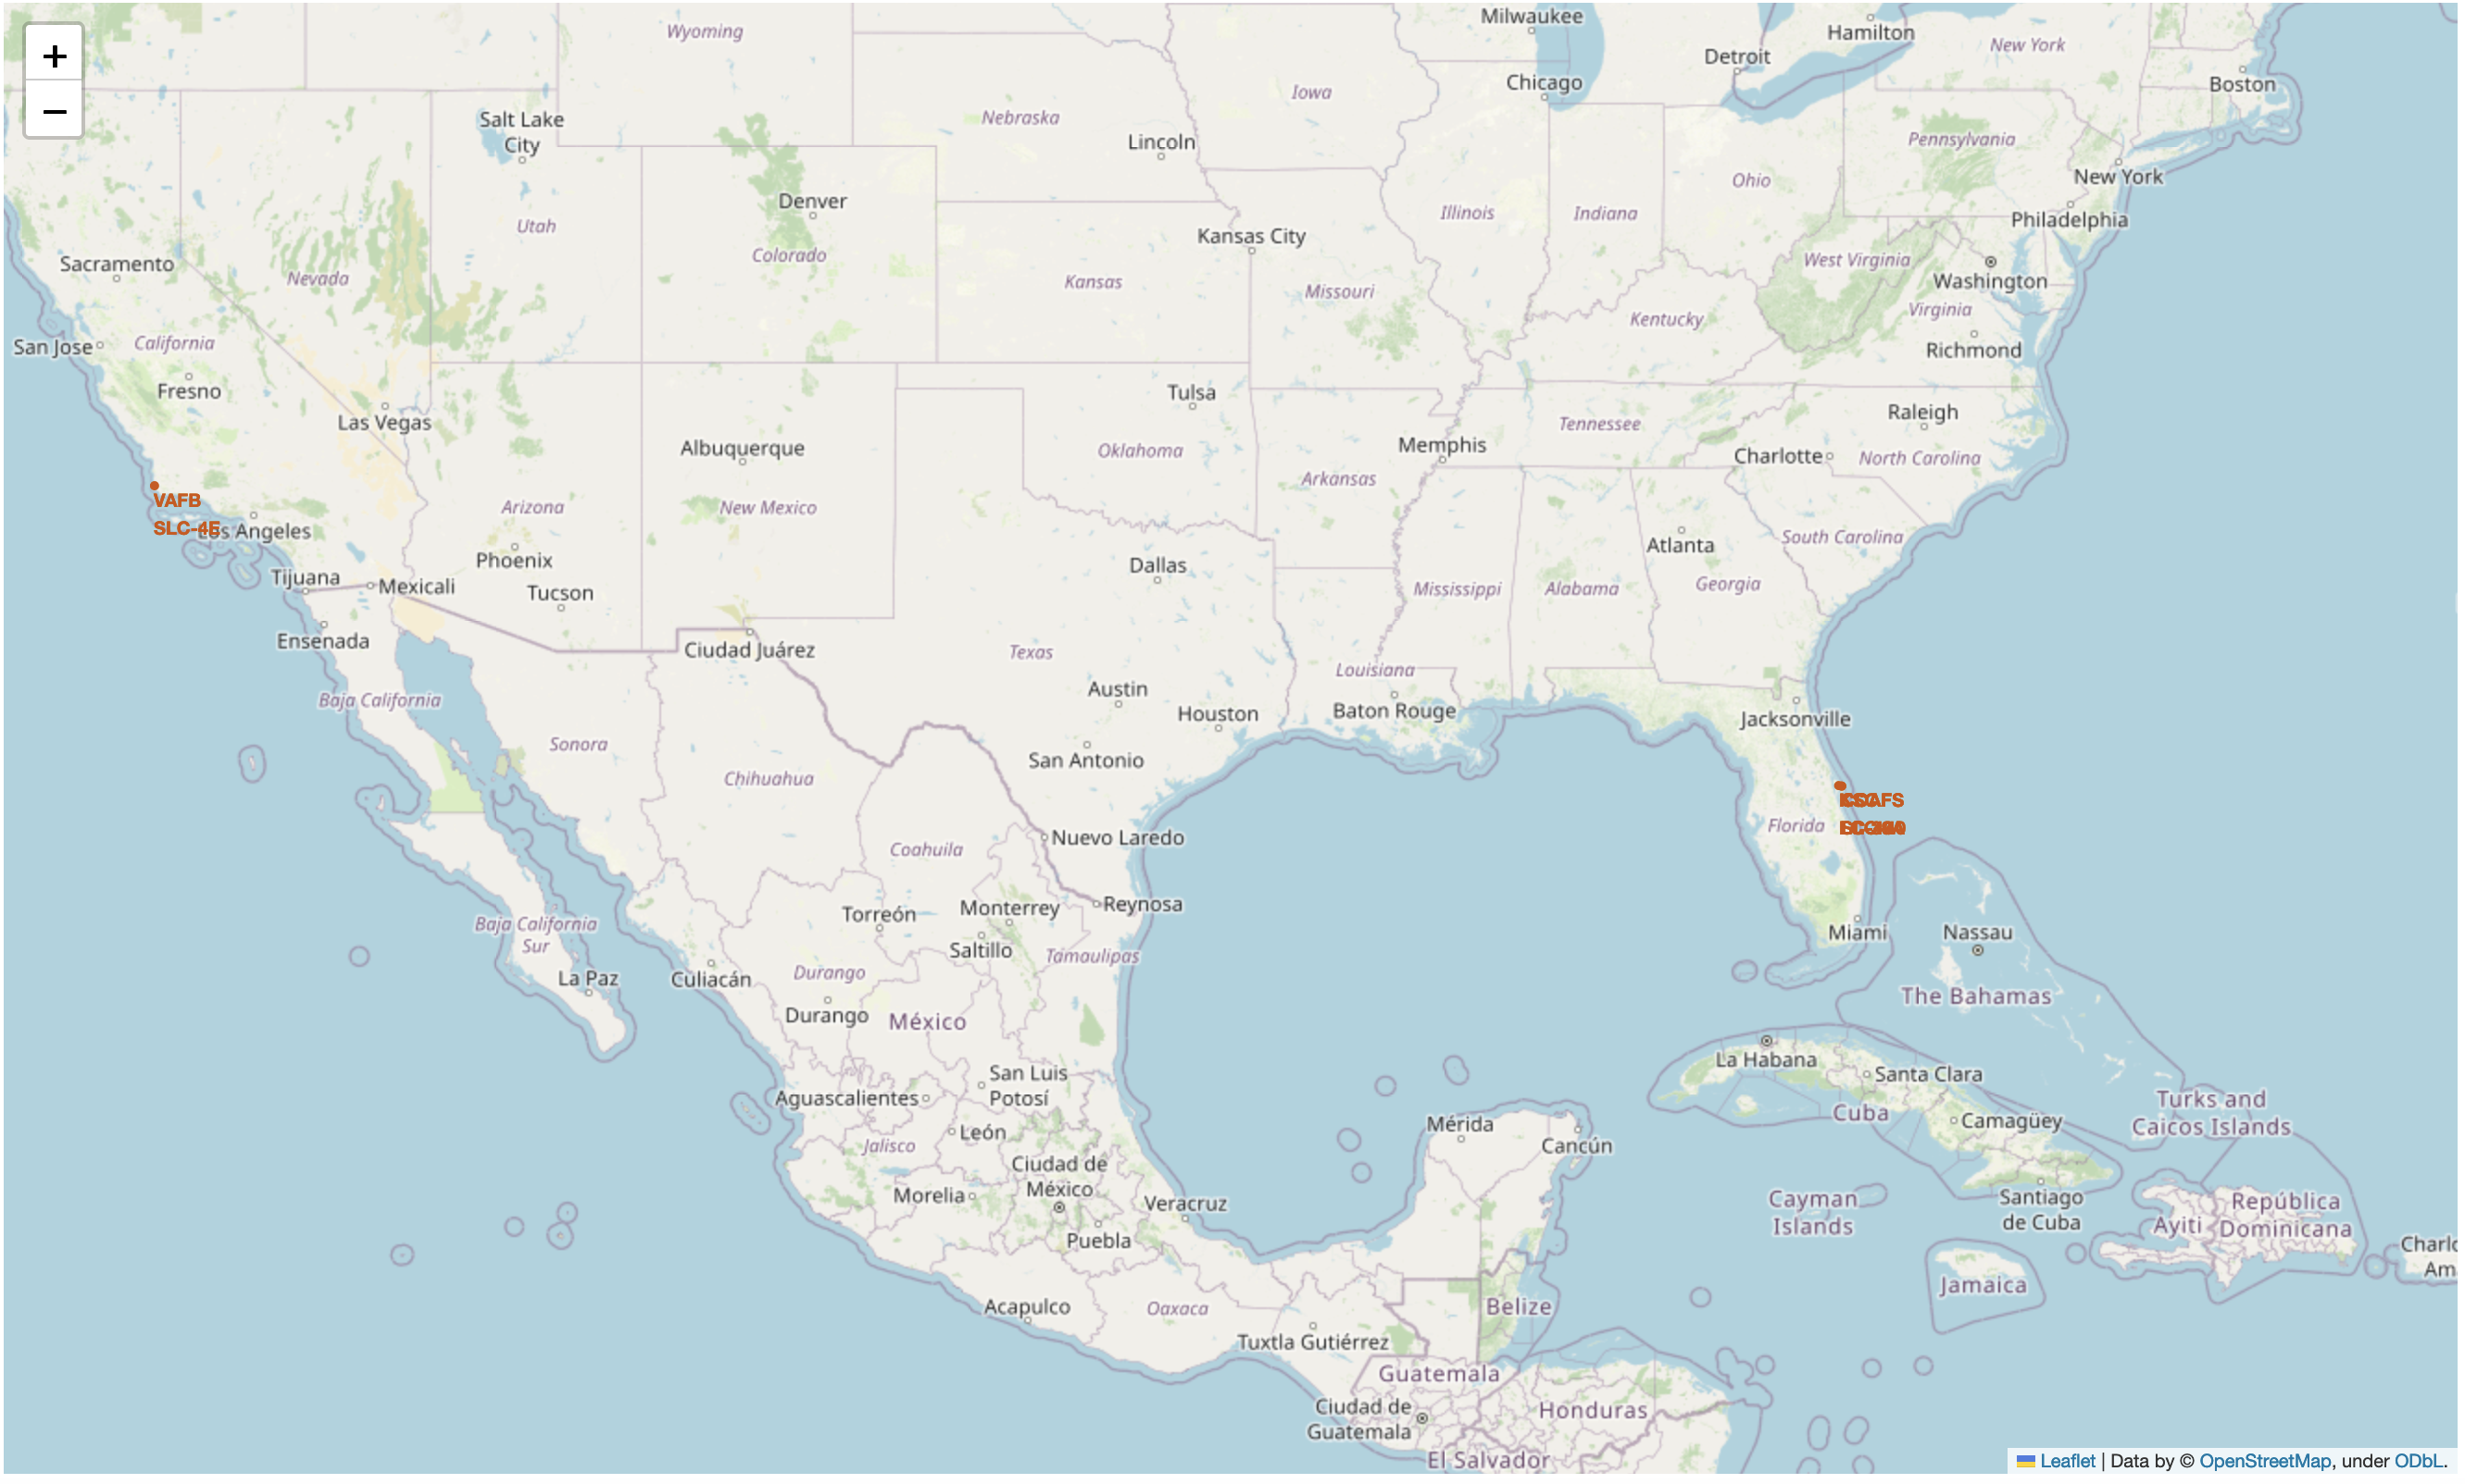
SpaceX Launch Sites in the USA
Note that all launch sites are in the southern (southeastern, southwestern) parts of the U, as these are closer to the Equator

Slide 36
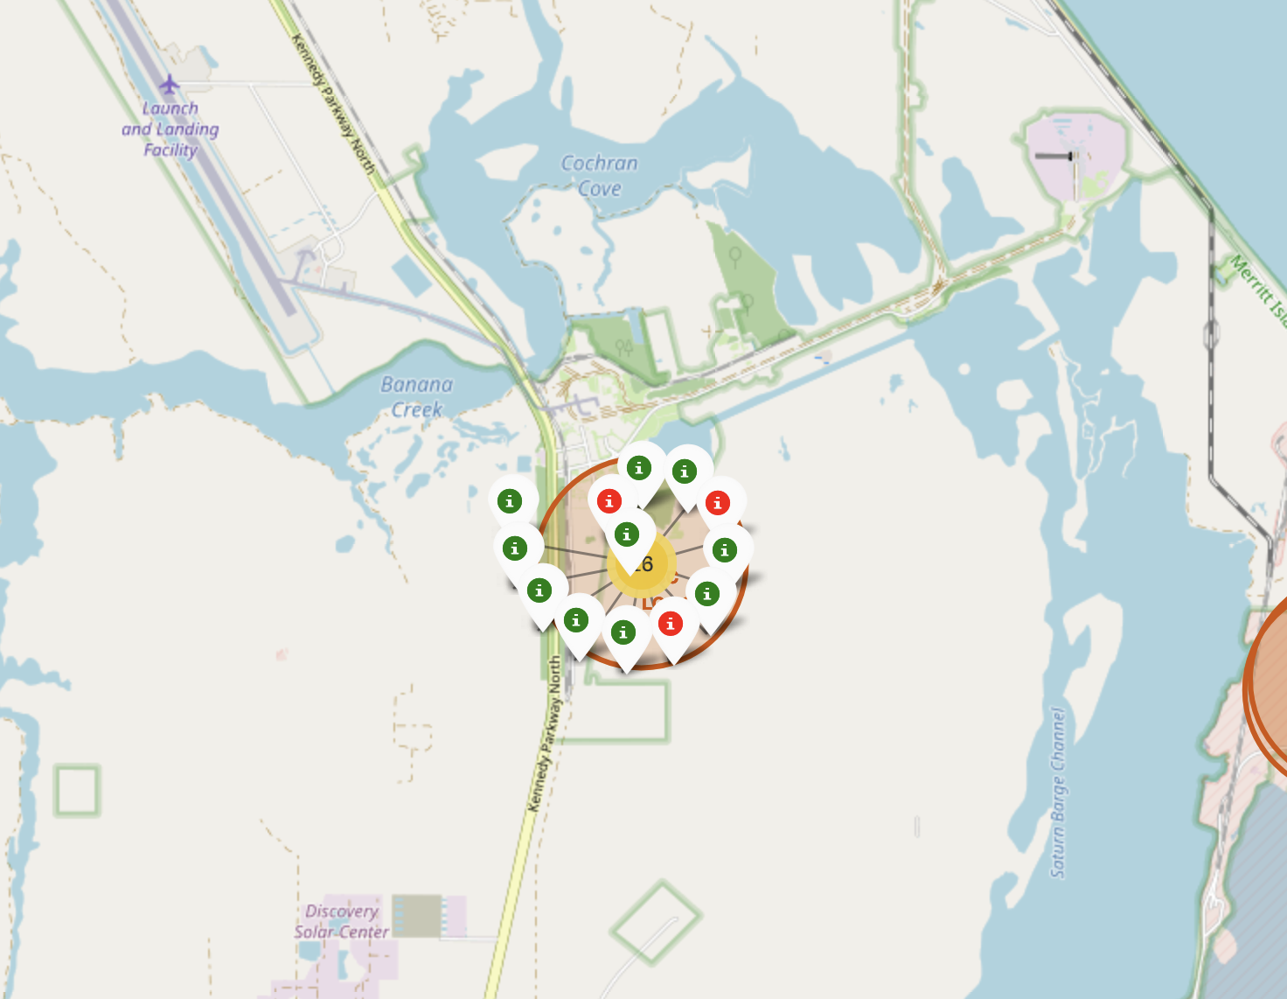
Launches at KSC LC-39A

Slide 37
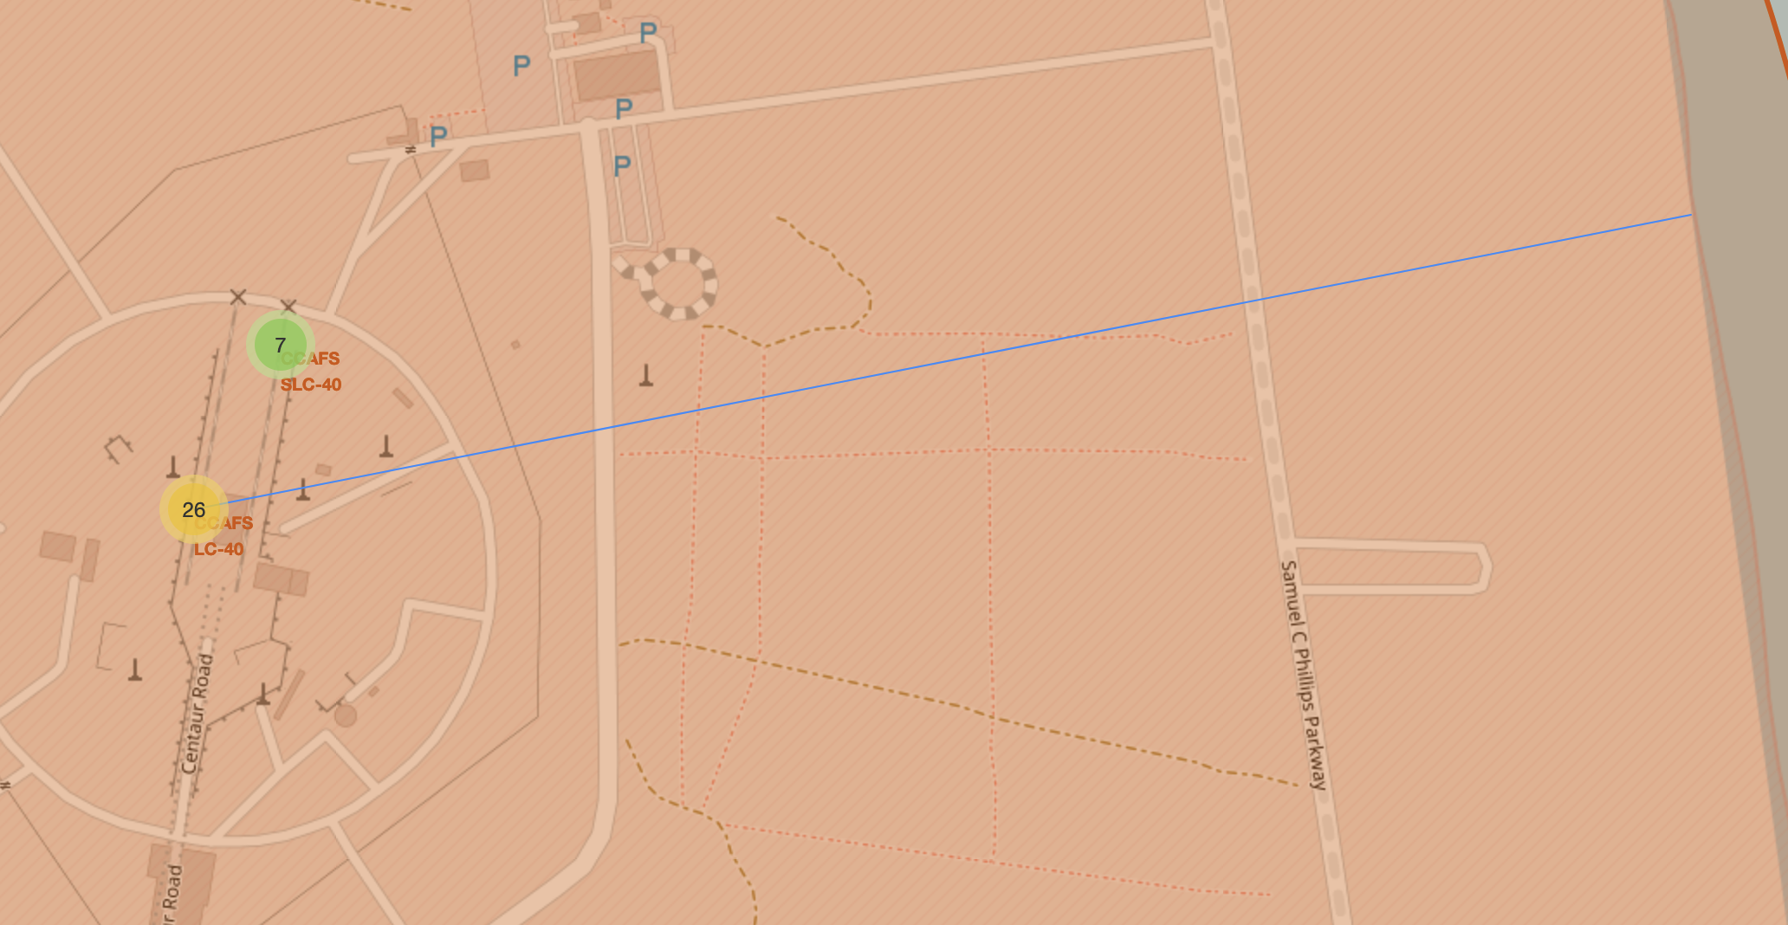
Distance between LC-40 and coastline

Slide 38

Section 4

Slide 39
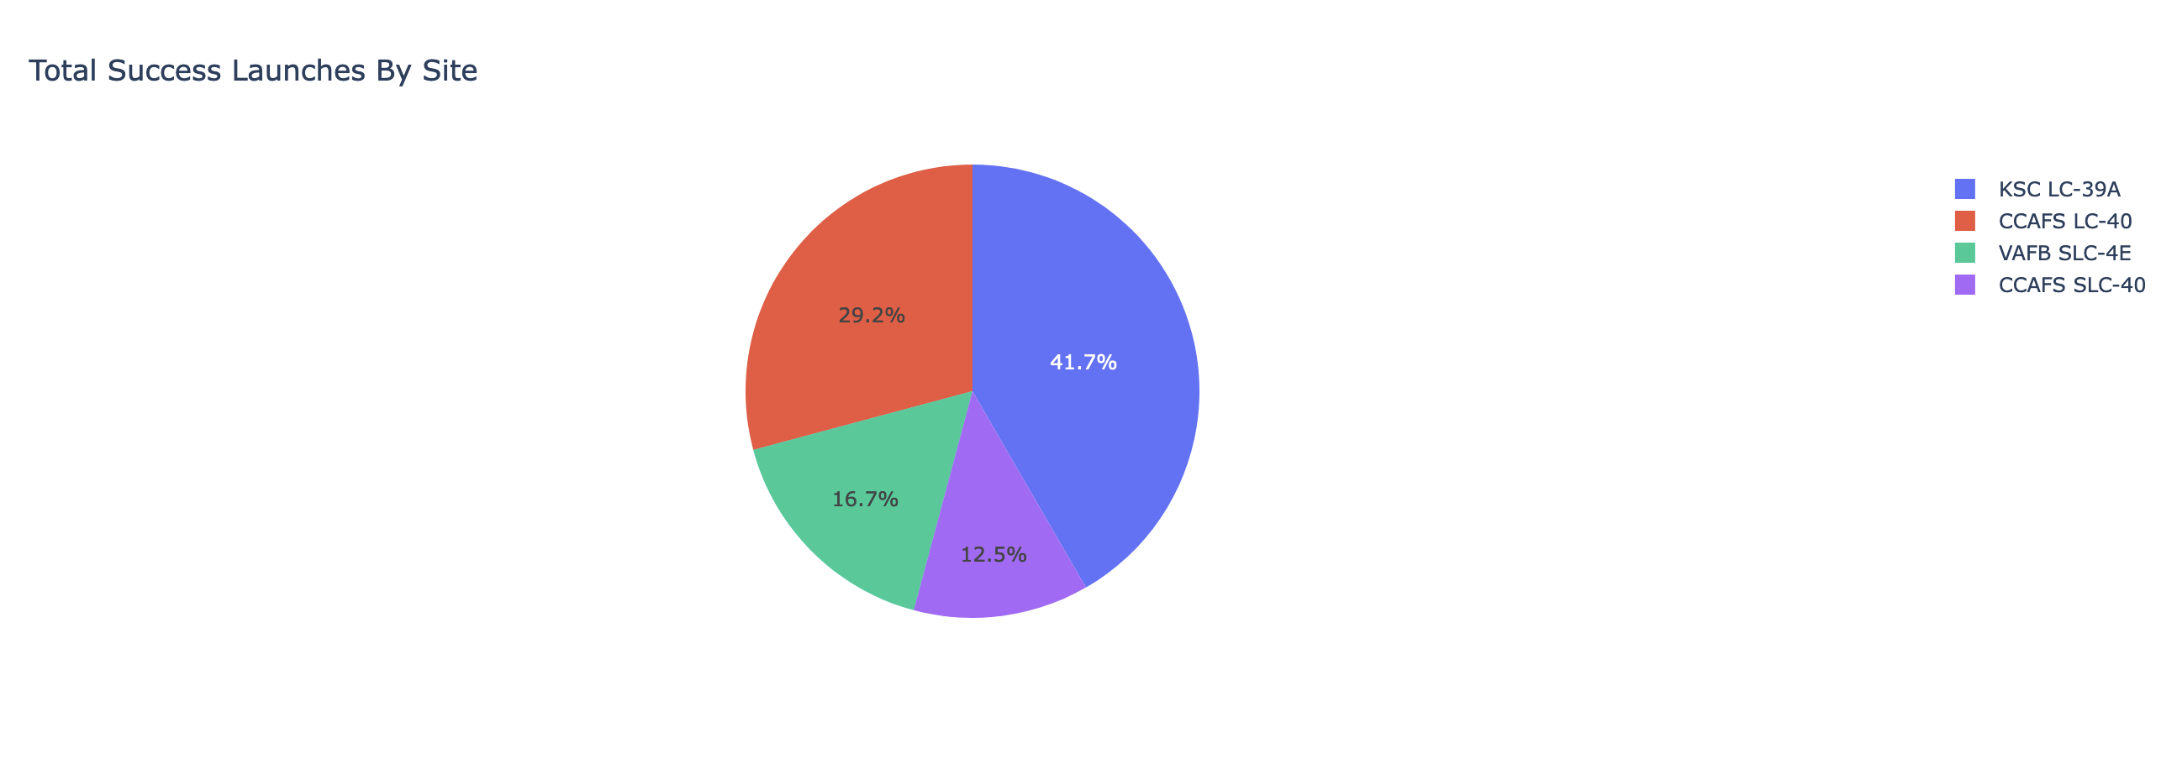
Launch Success, All Sites

Slide 40
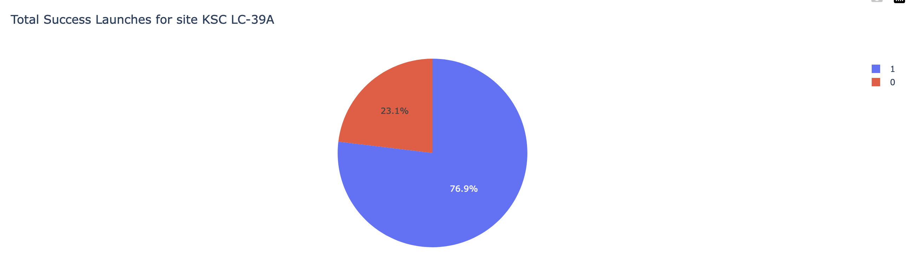
Success launch rates for KSC LC-39A

Slide 41
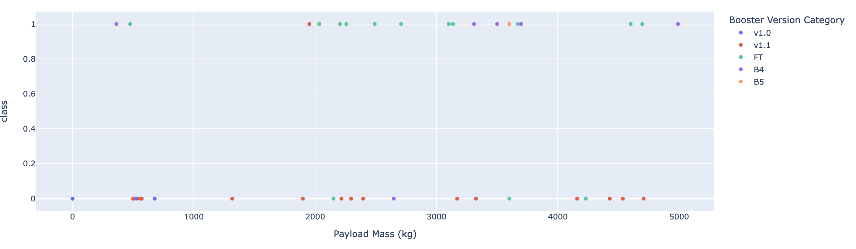
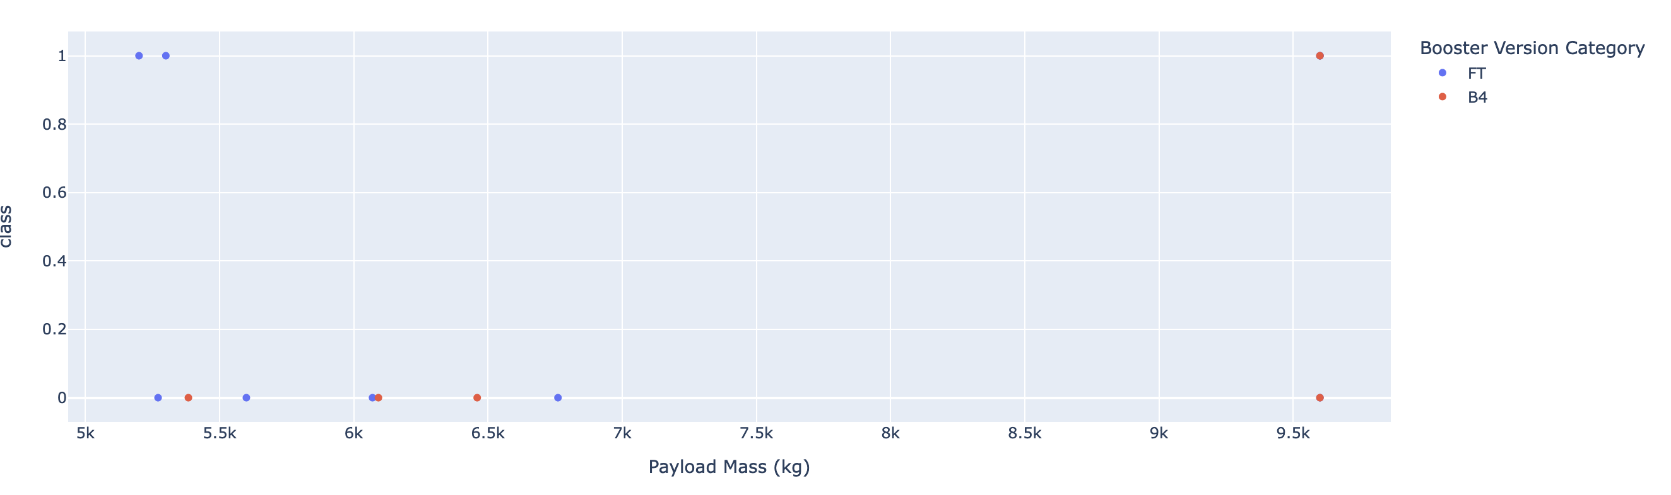
Launch Success Rates by Payload and Booster

Slide 42

Section 5

Slide 43
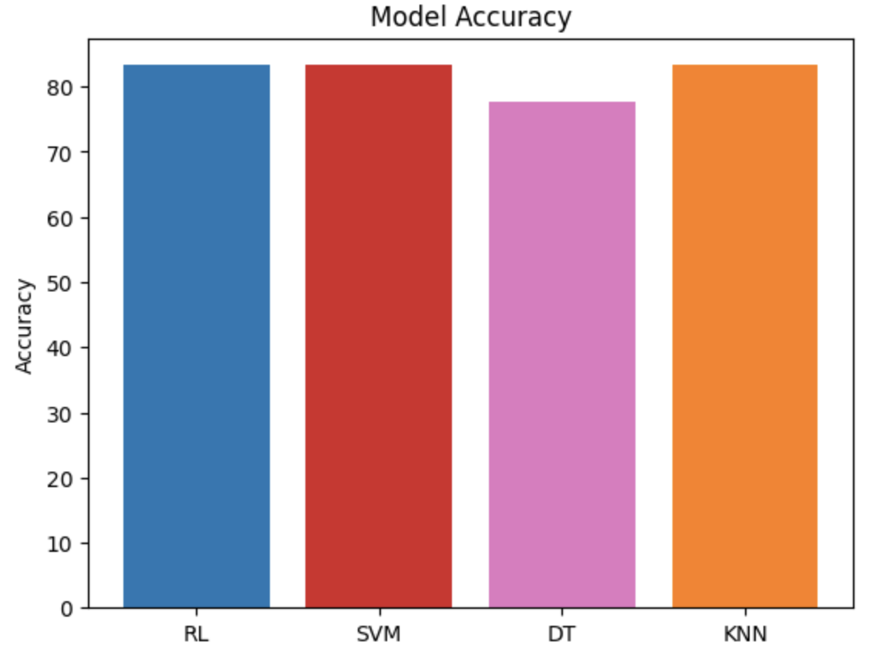
Classification Accuracy

Slide 44
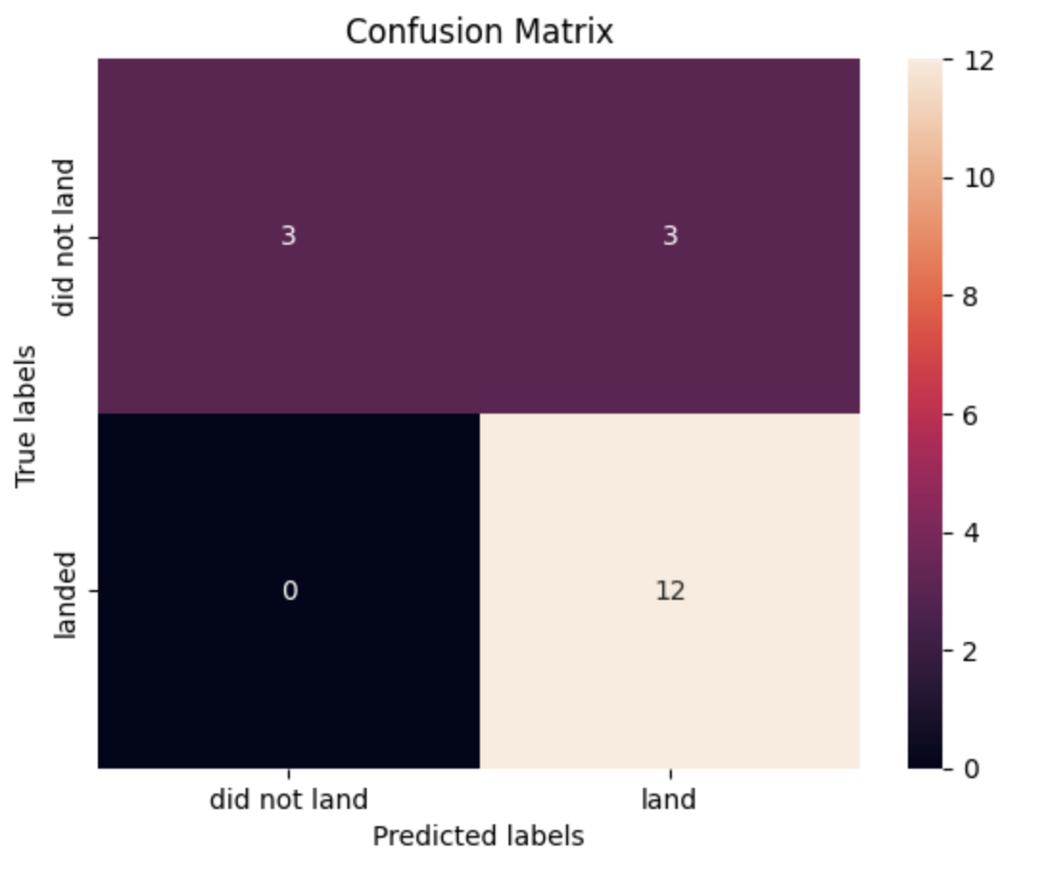
Confusion Matrix
The confusion matrix looks the same for the 3 best-performing models

Slide 45
Conclusions
Logistic regression, k-nearest neighbor, and SVM models displayed the best prediction accuracy (83.3%)
The decision tree model had the worst prediction accuracy (77.8%)
Success rate of launches improved over the years
Lower payload masses perform better than higher payload masses

Slide 46
Appendix
Include any relevant assets like Python code snippets, SQL queries, charts, Notebook outputs, or data sets that you may have created during this project

Slide 47


